Slide 1
Design and Development of Applications
for Mobile Devices
User Testing and QR Code Reader
Semester 1, 2019

Slide 2
Types of user testing
Acceptance testing
The user’s opinion
Ask questions
Usability testing
The user’s performance
Observe behaviour

Slide 3
Usability testing protocol
Task based
Examples
Schedule an appointment with John every Friday at 5.00pm for the rest of the semester
Send a meeting request to John and Jane for 31st March at 10.00am
Delete your appointment with John for Tuesday 14th April
In a complete test scenario, the set is chosen to provide 100% coverage of the functionality and navigation paths
Notes:
Usability testing is always task based
In order to observe a user, we must have some task to perform
Saying “have a go” is not a task
You aren’t always going to get 100% coverage, for example coming up with a task set that covers all the functionality and navigation for Excel. Hint: it will take you a long time…

Slide 4
Usability testing protocol
As an experimenter, you should:
Write down any errors, hesitations, difficulties or missteps
Record timings
As an experimenter, you should not:
Speak
Point or
Interfere
Notes:
After you have made a task set, you may run the test
The behaviour of both participants is very important
As an experimenter:
Remember that your job is to observe performance
Don’t help in any form. When the product is release, you won’t be there to help the user
It’s not a fair test if the experimenter is giving hints
If you want to get fancy, you can embed timers and key loggers in the software itself
The behaviour of both participants is very important
If they are struggling, you can’t interfere. You can watch how they try to solve the problem
You should not where the problems occur, but you can’t speak
There is one exception where you are working with children. If they happen to get to the point of frustration, you can interfere

Slide 5
Usability testing protocol
As a user, you should:
Think aloud
Notes:
The most effective testing approach is thinking aloud
The user is encourage to simply articulate every thought in their head
Note that this not “tell me what you think” as in ”give me your opinion”
“Say what is in your head”
Remember that some people are better at this than others, but everyone can do it with a little practice
In a serious user testing environment, the experimenter would give your subjects some practice with another application before starting on the real one

Slide 6
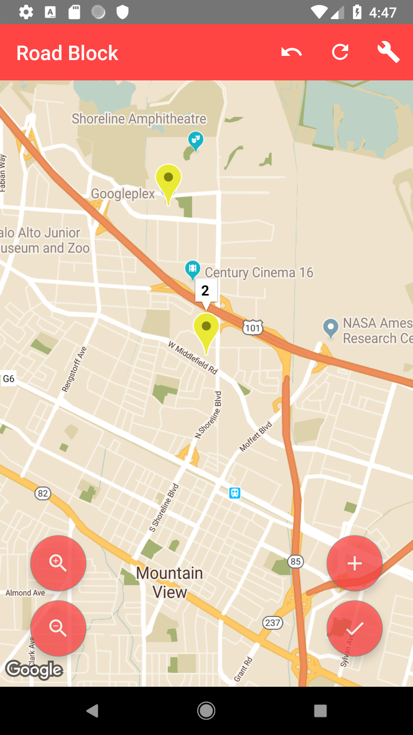
Acceptance testing
Acceptance testing
Place a marker and add it
Place another marker and add it
Create a traffic report
Undo the marker and place another marker
Revert the marker

Slide 7
Usability testing
Usability testing
User 1
Completion time – 4 minutes
Age – 20
Phone – Samsung Galaxy S6 Edge
Technical ability - strong

Slide 8
Results and modifications
User 1 successfully followed and completed each step
Issue 1 – When the user placed markers, it wouldn’t return any information
Solution 1 – Prompt the user saying “No traffic incidents were found.”

Slide 9
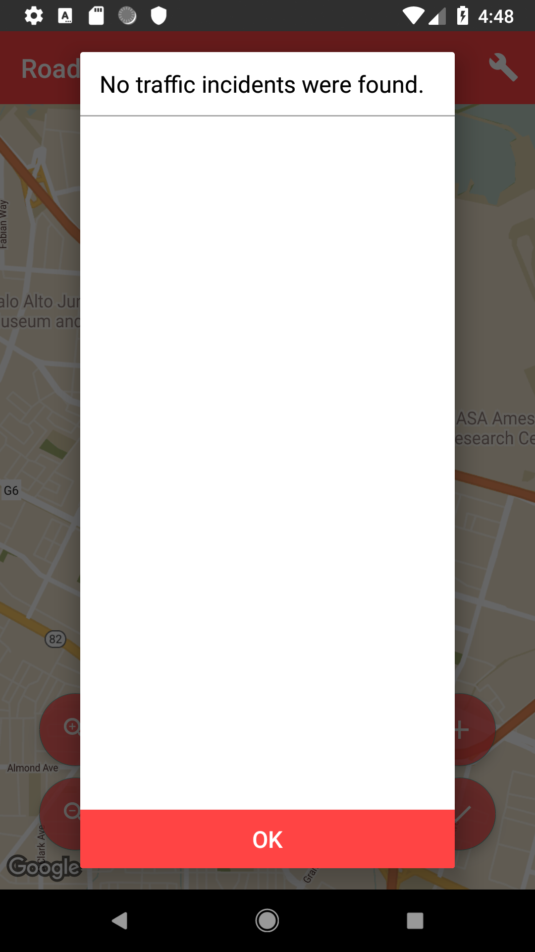
Outcome
Ask user 1 to test the app again

Slide 10
QR Reader
This app will:
Provide a main activity with a button that starts the camera feed
Display the camera feed in a second activity which performs the QR code reading
Return the QR codes text value from the second activity to main activity

Slide 11
Practical
Have your app display, for each code read, the total count of each month read so far
Have your app detect when a URL is found, and navigate to the web page
I have provide a collection of QR codes ”qr-codes”

Slide 12
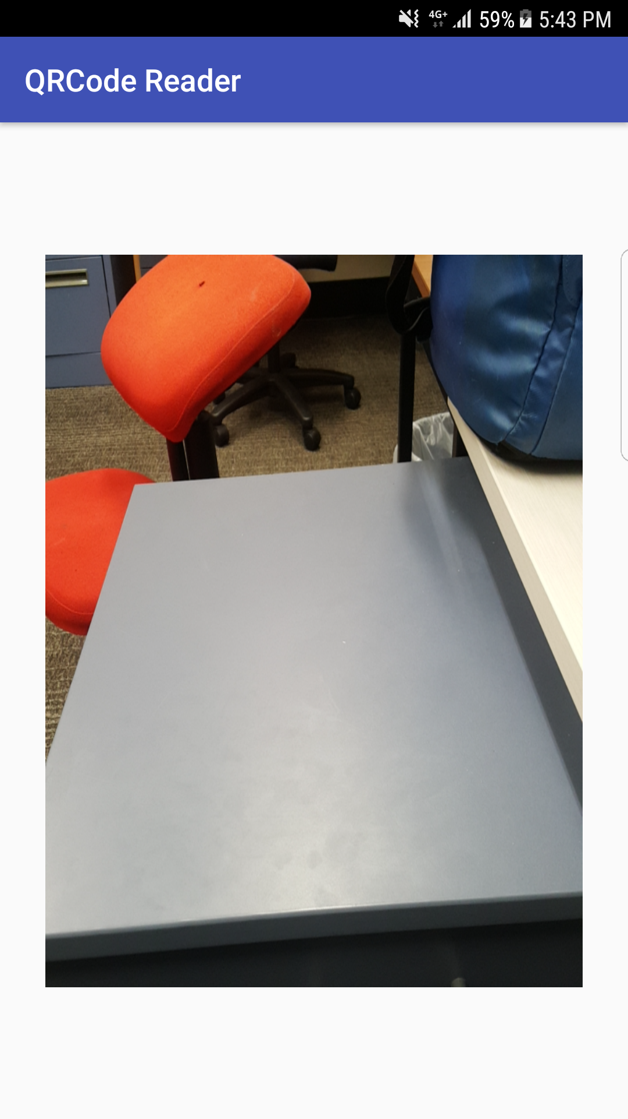
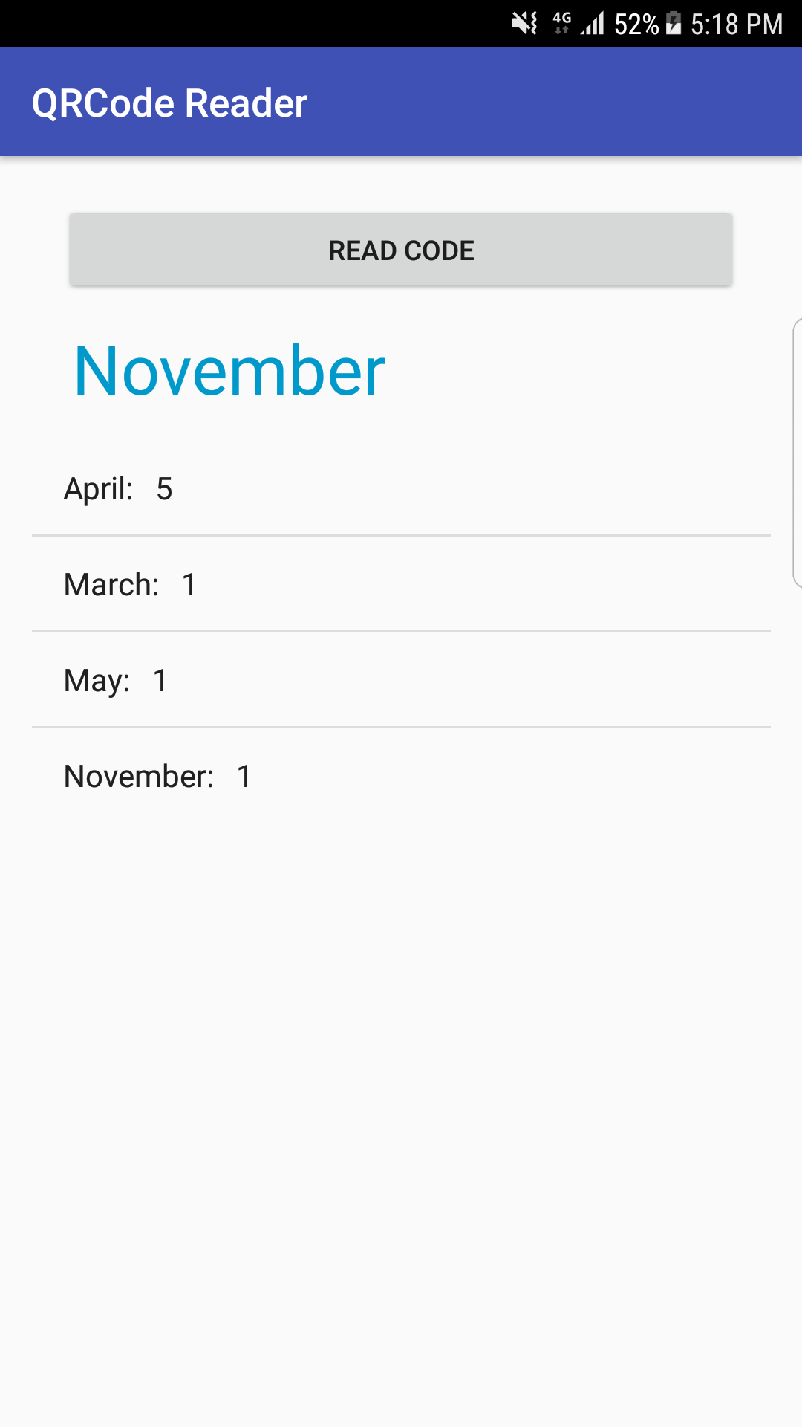
Practical example

